Slide 1
Methods of Iteration
For loops, apply functions, and so much more in purr
R Users
Jordan DiNardo
2/18/2021

Slide 2
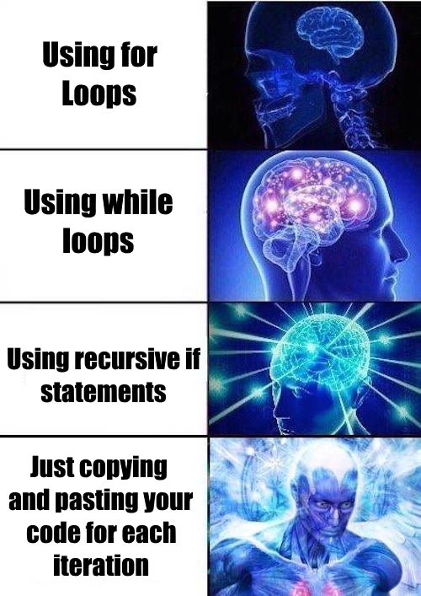
Iteration is everywhere!!
Reading in data files
Data manipulation
Performing statistical analyses
Developing plots across treatments, species, locations, etc.
split–apply–combine pattern

Slide 3
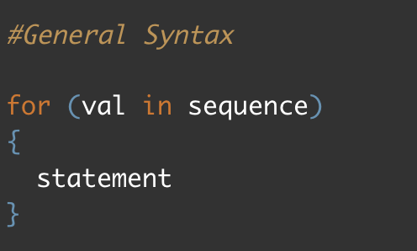
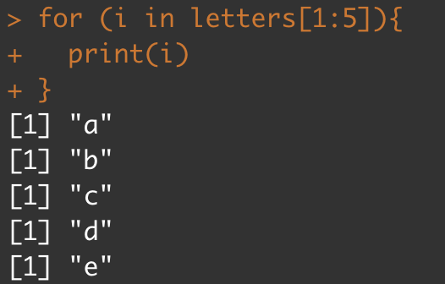
For Loops
The ‘OG’ form of iteration in computer science
Use indexing to “loop” over values in a vector and do something to each value

Slide 4
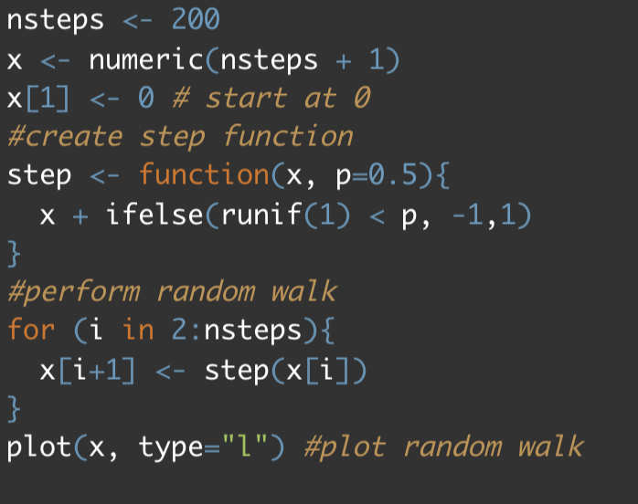
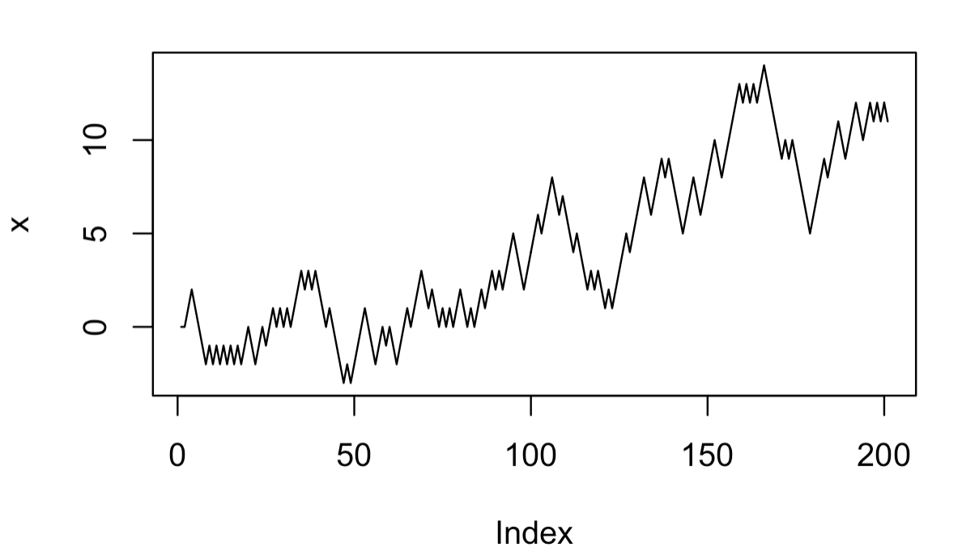
For Loops
Beneficial when the output of one iteration depends on the result of the previous iteration.

Slide 5
Apply Functions
These functions iterate like a loop and are generally more efficient
“The point of the apply family of functions is not speed, but expressiveness. They also tend to prevent bugs because they eliminate the book keeping code needed with loops.” Hadley Wikham
apply(): most basic function; takes an array or matrix
lapply(): takes a vector or list, and returns a list
sapply(): same as lapply(), but will return the most simplest output
vapply(): similar to sapply(), but you specify the expected output
mapply(): similar to sapply(), but used when function takes multiple arguments
Notes:
On stackoverflow there is a over-emphasis of on how apply functions trump for loops in speed, which may be true , but apply functions are really beneficial in making your code easier to read, supposedly easier to parallelize your code, discourages human error, and doesn’t require saving a bunch of objects in the global environment.

Slide 6
Switch to code…

Slide 7

Let’s learn to purr
map functions, list columns, and nested data
Notes:
Purrr is one of those tidyverse packages that you keep hearing about, and you know you should probably learn it, but you just never seem to get around to it. At it’s core, purrr is all about iteration. Purrr introduces map functions (the tidyverse’s answer to base R’s apply functions, but more in line with functional programming practices) as well as some new functions for manipulating lists. While the workhorse of dplyr is the data frame, the workhorse of purrr is the list.

Slide 8
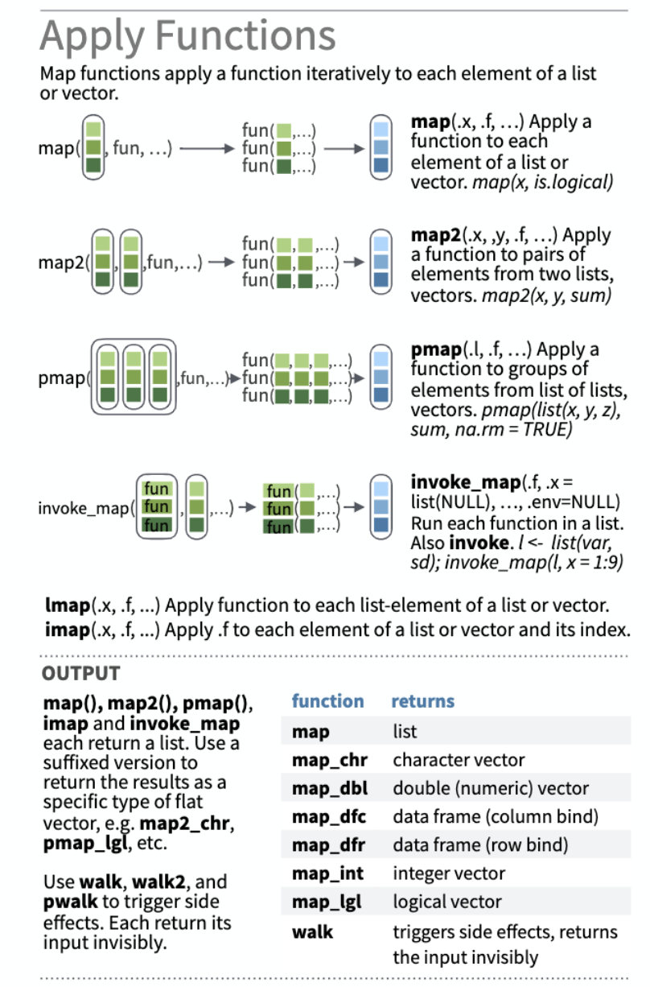
Map Functions
Similar to base r apply functions
Transform their input by applying a function to each element of a list or atomic vector and returning an object of the same length as the input.
Works with lists, vectors, and data frames
Notes:
While there is nothing fundamentally wrong with the base R apply functions, the syntax is somewhat inconsistent across the different apply functions, and the expected type of the object they return is often ambiguous (at least it is for sapply…).
The naming convention of the map functions are such that the type of the output is specified by the term that follows the underscore in the function name.

Slide 9
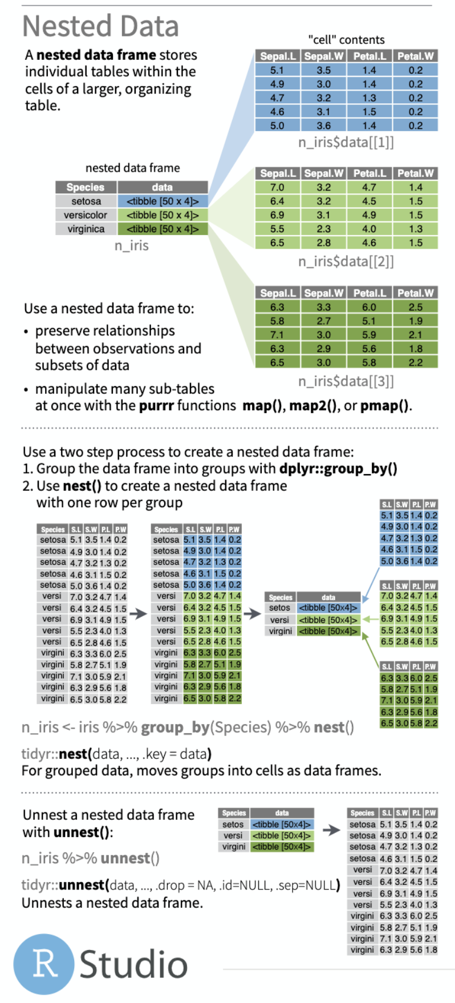
List Columns and Nested Data
Tibbles (nested data)
Tibbles are tidyverse data frames
tibble columns can be lists (as opposed to vectors, which is what they usually are)!!
tibble can be “nested” where the tibble is essentially split into separate data frames based on a grouping variable, and these separate data frames are stored as entries of a list (that is then stored in the data column of the data frame).
List columns
A list that is stored in a column vector of a dataframe

Slide 10
Switch to code…

